Slide 1
Fig 1. Schematics

Slide 2

F
T_{a}
atmosphere
mixed layer
T_{s}
deep ocean
T_{o}

Slide 3
Fig 2. Forcing, plus IPCC

Slide 4
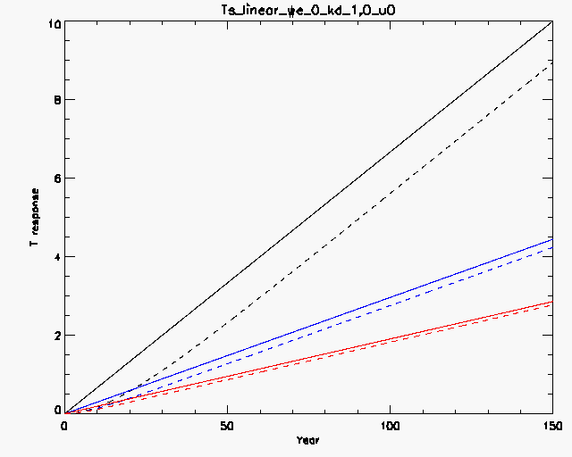
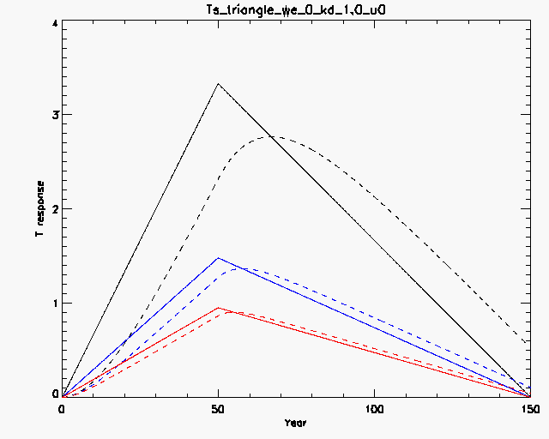
Fig 3. mixed layer response, initial time

Slide 5
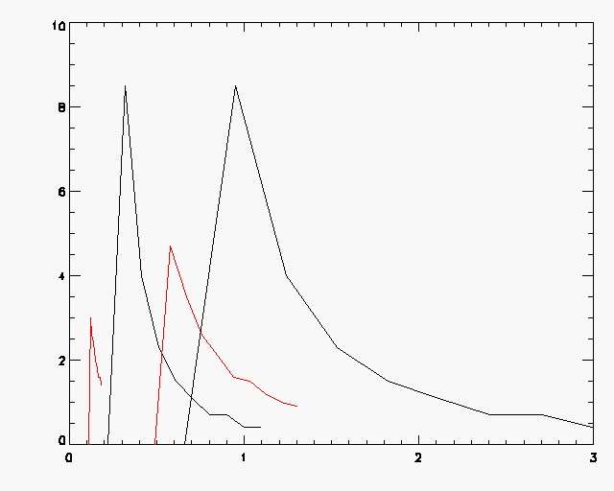
Figure 5 histogram, plus another T for triangle forcing

Slide 6
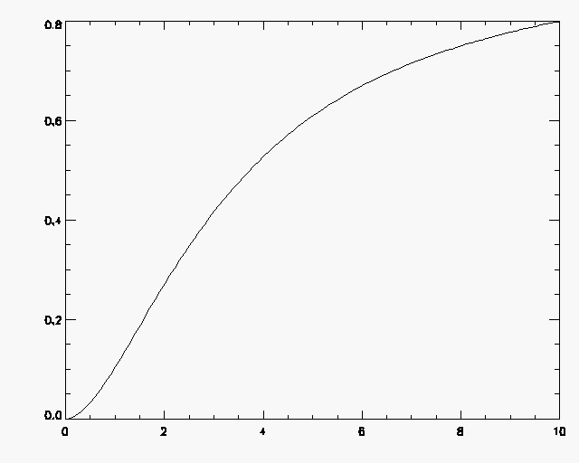
Fig 4. Sensitivity to cloud feedback

Slide 7
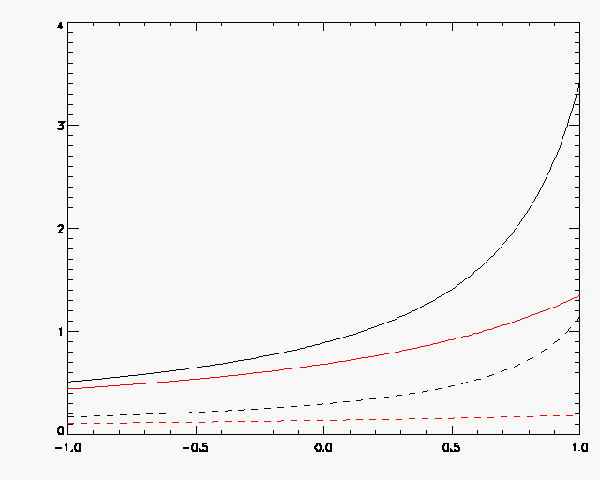
Fig 6. Sensitivity to cloud feedback, Tse and Ts mixed layer

Slide 8
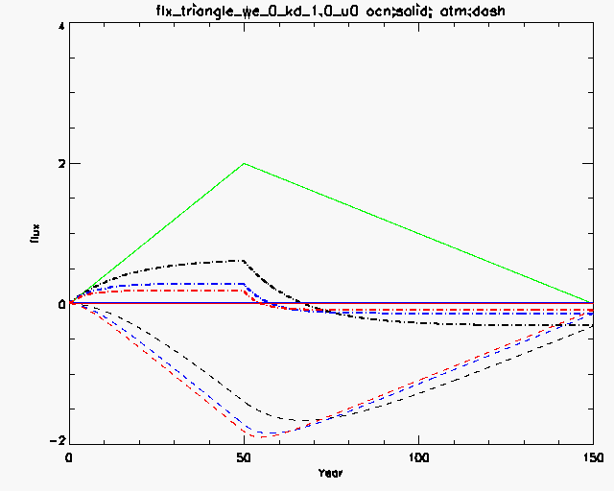
Figure 7

Slide 9
Deep ocean

Slide 10
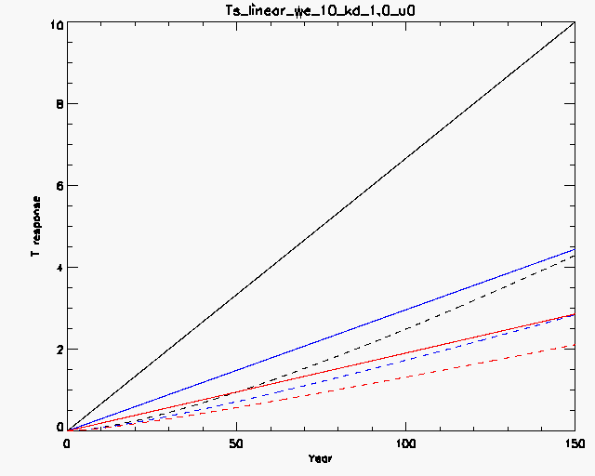
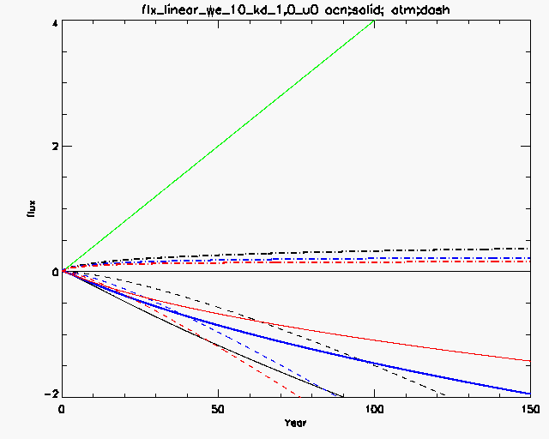
Figure 8
Figure 6 T

Slide 11
A scatter plot of the effective heat capacity?

Slide 12
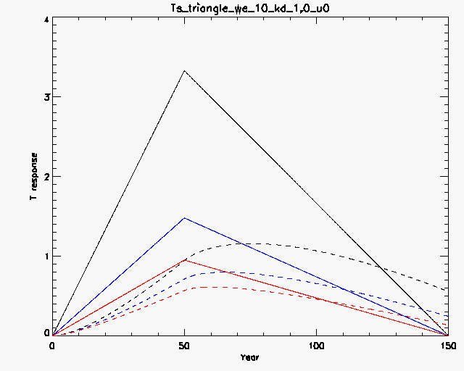
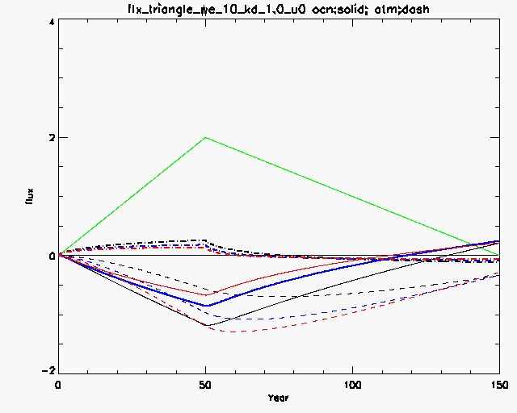
Figure 9

Slide 13
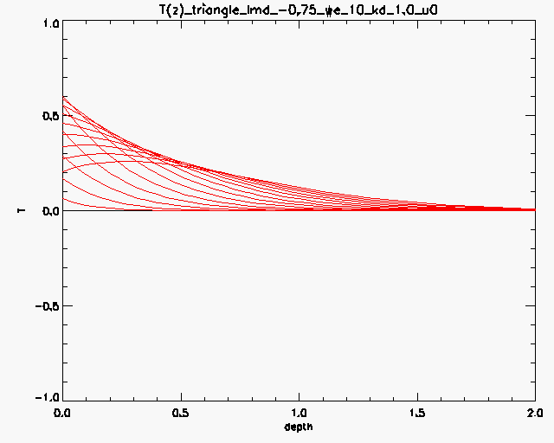
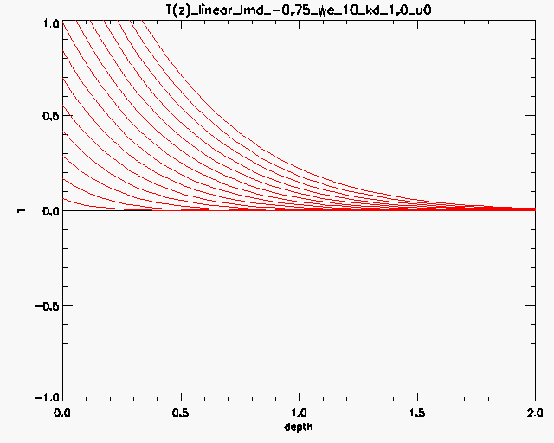
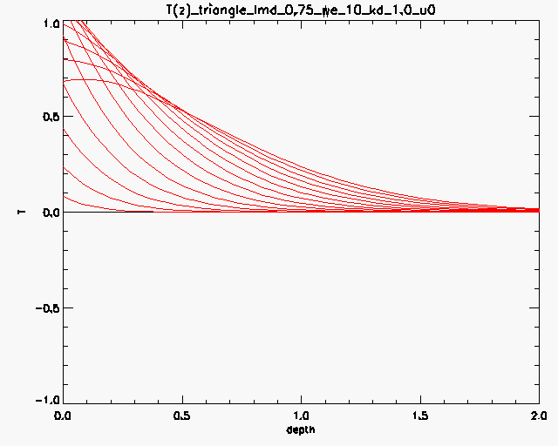
Figure 10

Slide 14
Figure 9 histogram2, for triangle

Slide 15
Sensitivity

Slide 16
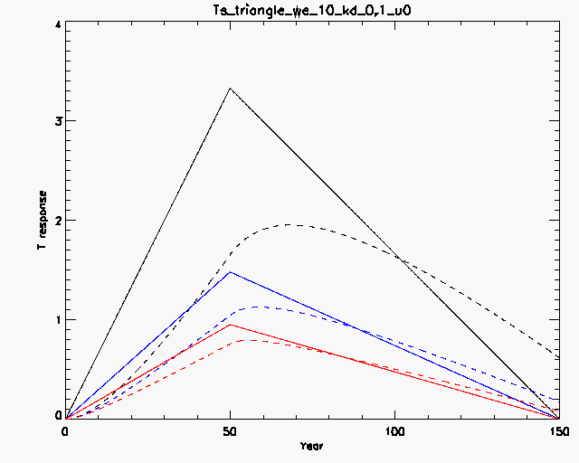
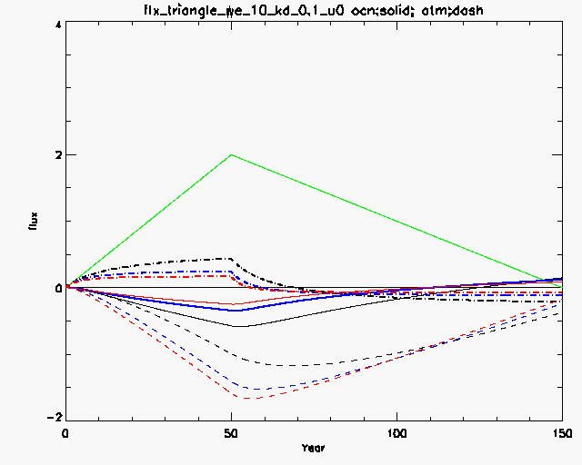
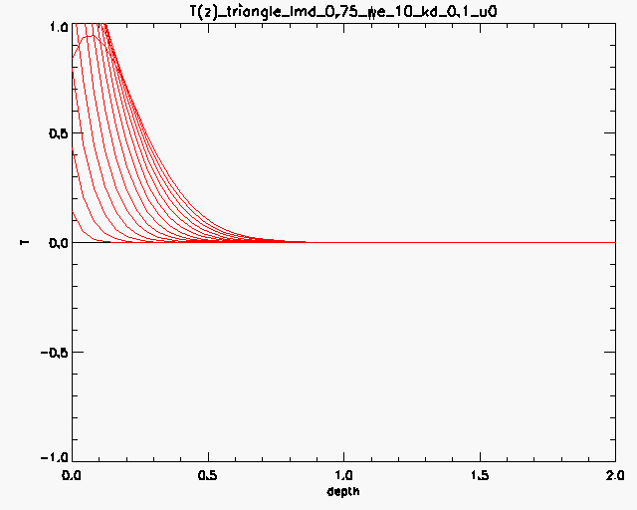

Slide 17
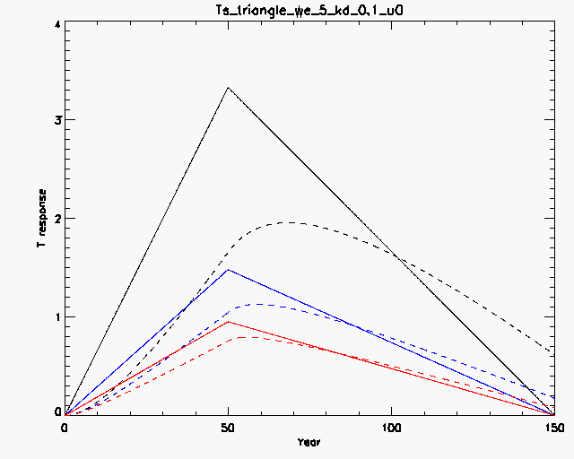
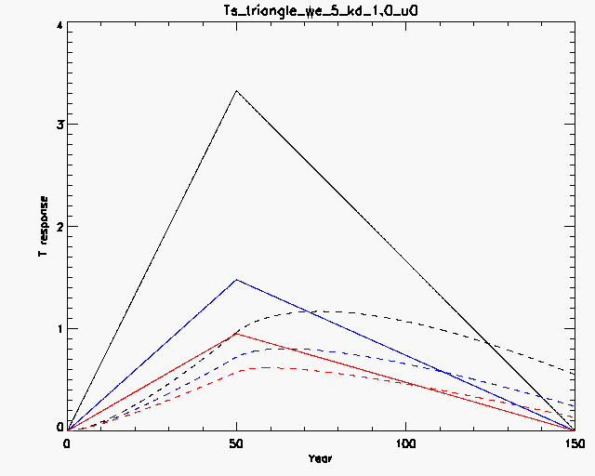

Slide 18

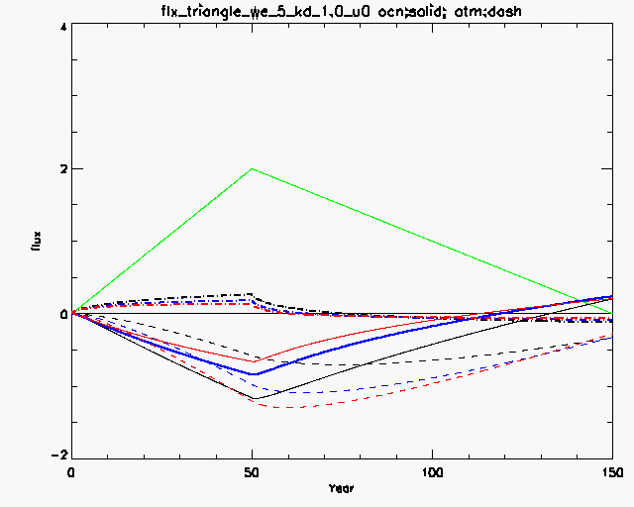

Slide 19
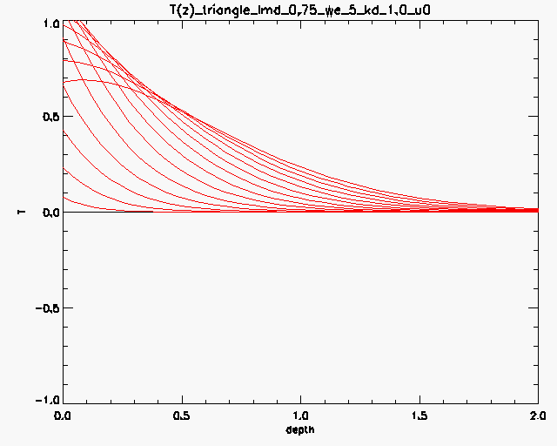


Slide 21
Sensitivity to u and discussions, re-calculate to reduce u

Slide 22
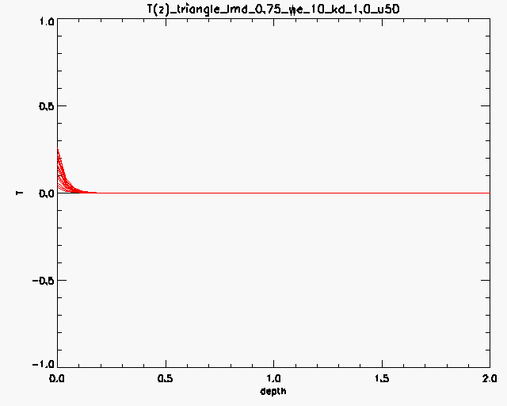
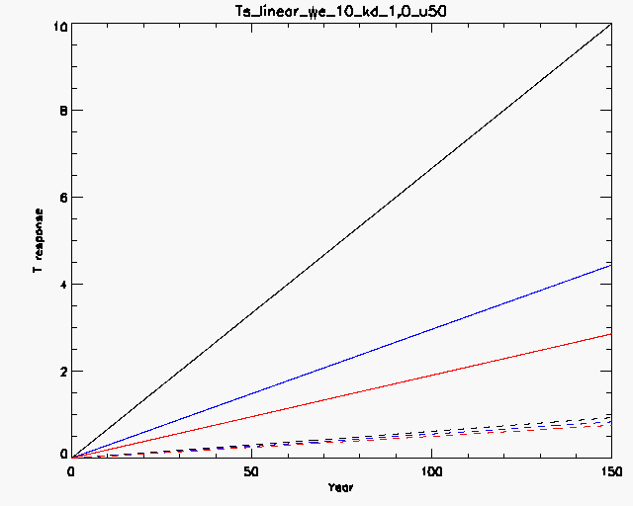
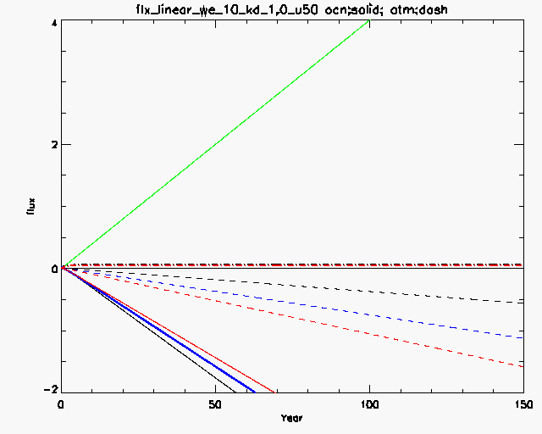

Slide 23
Figure histogram3, plus another T for triangle forcing
Make u smaller!

